Slide 1
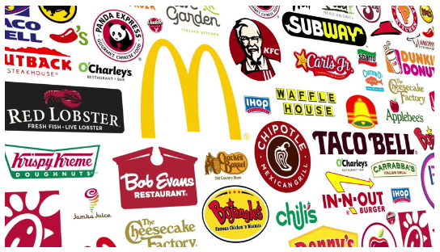
Data Analysis Of The Fast Food Restaurants in USA

Slide 2
Problem Statement
This data set is from a survey on the Food chain restaurants through out the USA.
We have to analyse the data set to draw some conclusion that will be beneficial to the business.

Slide 3
Why this is useful?
We have a dataset of 10k records of different restaurants in different cities under different province in USA
Based on the huge data set we have done analysis
to provide you the useful idea about the
* Distribution of the Restaurants location wise
* Comparative analysis through graphs
* Conclusion

Slide 4
Data Overview
We have 10K records having the following columns 10 columns:
address, city, country, keys, latitude, longitude, name,
postalCode, province, websites.
Latitude and longitude column data are numeric and rest are object type.
Some missing values in websites column.

Slide 5
What has been done?
Analysed the data types and get a view of the sample of the data set.
Profiling the data with pandas.
Modified the name field with proper value.
Missing values analysis and imputation.
Categorised data in suitable way to have better visualisation
Prepared graphical representation of the data

Slide 6
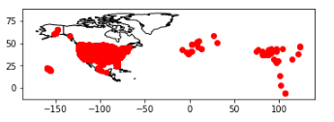
Distribution of Restaurants in North America map

Slide 7
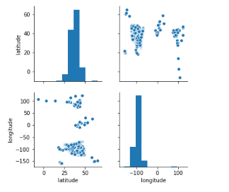
Pair plot for latitude and longitude

Slide 8
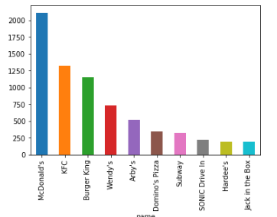
Bar chart- Restaurant counts for top Companies

Slide 9
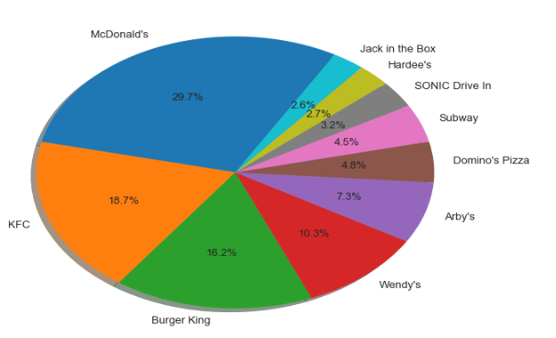
Pie chart -Restaurant count

Slide 10
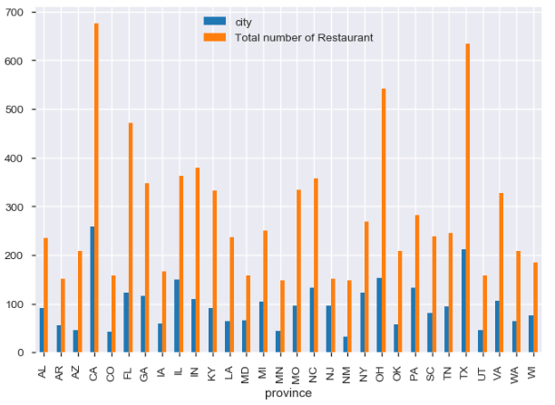
Bar plot- Province Vs City count/Restaurant count

Slide 11
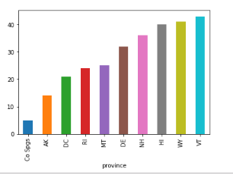
Province with less number of Restaurant

Slide 12
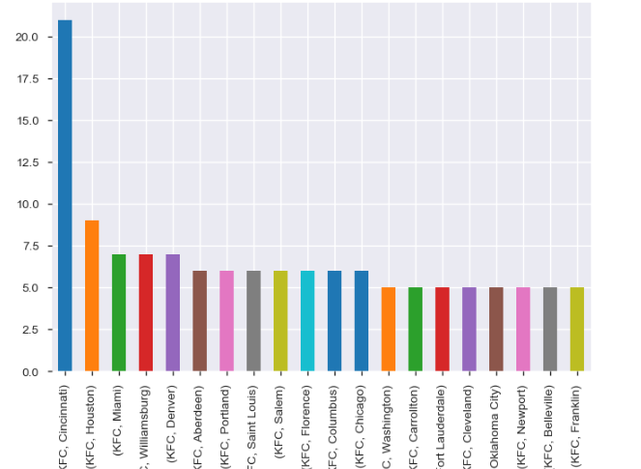
KFC restaurant distribution through out the different cities

Slide 13
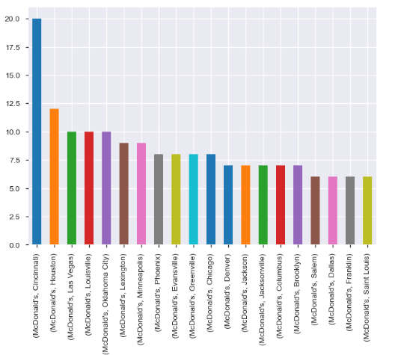
McDonald’s distribution through out the different cities

Slide 14
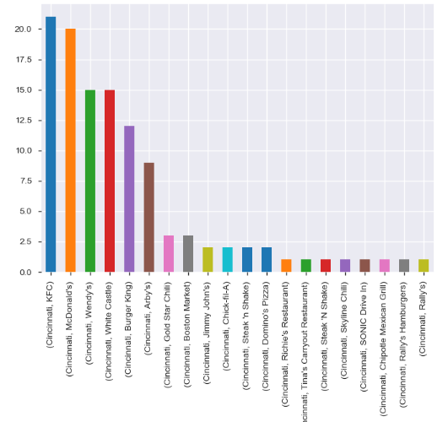
Restaurant distribution in Cincinnati city

Slide 15
Conclusion
All the records are mainly of North America, No records for South America that we have found from latitude-longitude plotting in geopanda.
Some cities have very few number of restaurants. There might be some feasibility analysis on the growth of restaurant business in those cities.
McDonald ’s has the most number of restaurants in USA followed by KFC and burger king respectively.
Cincinnati city has the most number of restaurant in USA.
Those restaurants which don’t have websites data after the logical modification in this record might not having their own websites or data is missing in this data set.

